Slide 1
What’s in your bucket?
Matt 15: 3 & 7-11

Slide 2
Did you ever smash you finger or thumb?
What did you say?
People use phrases when they say something like
That slipped, I don’t know what got into me, I didn’t mean to say that,
Yes, you did!

Slide 3
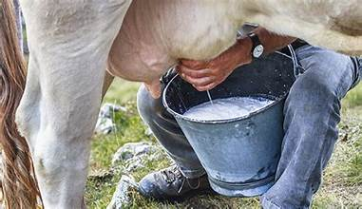
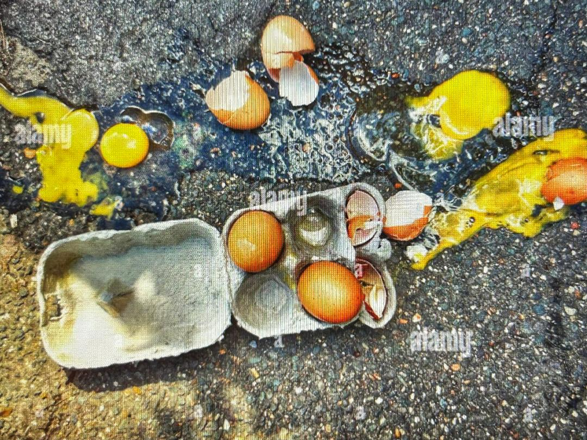

Slide 4
Mark 7: 1-23
The Jews Tradition concerned clean hands, not so much the heart
Philippians 4:8
Finally, brethren, whatsoever things are true,
James 3: 8-17 No one can tame the tongue

Slide 5
The only thing that comes out of us is what we put in
Remember the bucket of milk !!
Eph 4:29 NLT, Don’t use foul or abusive language.
Eph 5: 3-5 NKJV But fornication and all uncleanness or covetousness, let it not even be named among you, as is fitting for saints

Slide 6
I mentioned about our language but what about the use of "SLANG“
Definition of Slang, Websters dictionary, an informal nonstandard vocabulary composed typically of coinages, arbitrarily changed words, and extravagant, forced, or facetious (joking or jesting often inappropriately) figures of speech

Slide 7
Slang words are derivatives
Websters: a word formed from another word
(example) The word “childish” is a derivative of “child.”
Some slang words are not a problem (see above word) others might be questionable and in the case of some other words VERY QUESTIONABLE.

Slide 8
Don’t think so go to a library or on the internet and look up, URBAN Dictionary and look up these words, a normal part of everyday language
Heck
Gosh
Darn it
Shoot
Dog gone it
Crap
and the emojis we use🙂

Slide 9
If your Bucket of Life is knocked over
What will spill out
Christ or filth?

